Slide 1
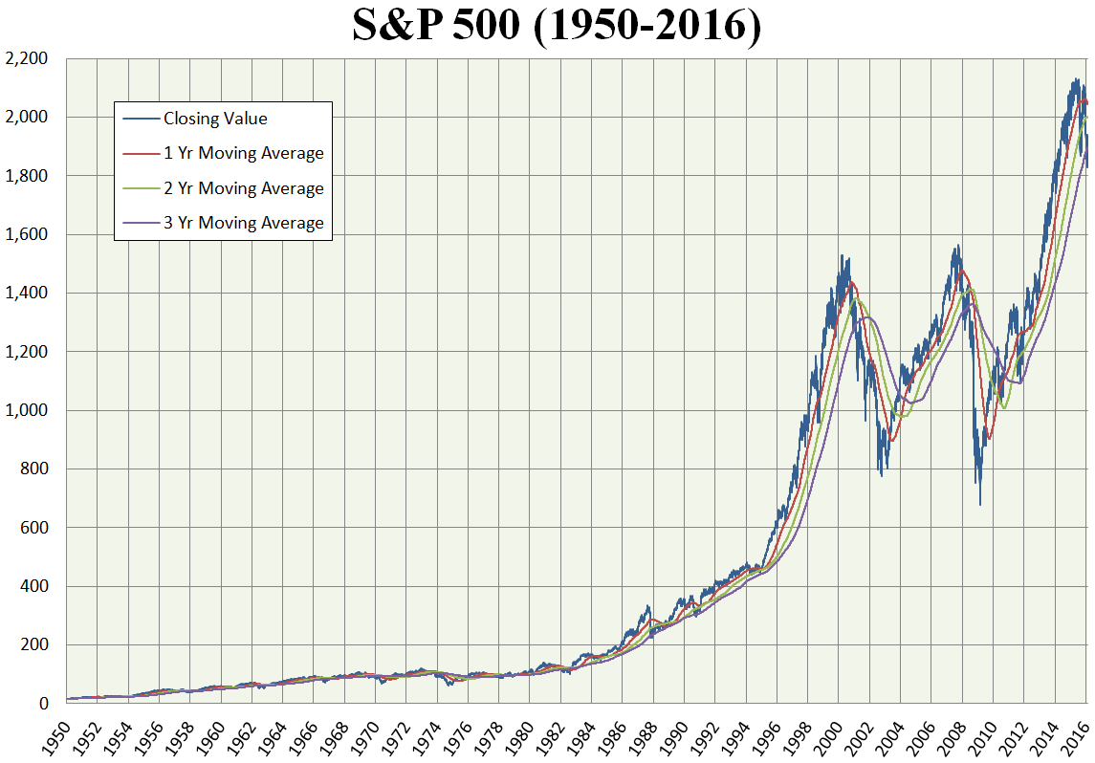
Historical S&P 500 Stock Analysis
DATA WIZARDS
(Raphael Joseph, Ramamurthy Sundar, Richard Yu, Wissemeddine Touati, Rishi Thakur)

Slide 2

Index
Team/Background
Project Idea/Definition
Steps in Project
Demo
Project Considerations
Q&A

Slide 3

Project Background/ Team Description
Topic Choice: Stock Market Historical Analysis
Problem Definition/Project Question: How do the top sectors of the S&P 500 impact the trend of the market?
Wissemeddine- Team Leader
Ram- Data Wrangler
Raphael- Trend Analysis
Richard- Visualization
Rishi- Powerpoint

Slide 4
Step 1: Sector Analysis
Find Top Companies (https://datahub.io/core/s-and-p-500-companies-financials/r/constituents-financials.csv)
Top 4 Sectors (Info Tech, Financials, Health Care, Consumer Discretionary)
Total of 11 sectors in S&P
Look into top 4 sectors
Sector | Price | Price/ Earnings | Dividend Yield | Earning/Share | 52 Week Low | 52 Week High | Market Cap | EBITDA | Price/Sale | Price/Book
Information Technology | 8347.00 | 2602.59 | 85.99 | 217.70 | 9714.50 | 6432.40 | 6727121800912 | 4.31e+11 | 411.61 | 761.15
Financials | 6055.81 | 1169.53 | 137.17 | 301.71 | 6923.88 | 4943.22 | 3442649464852 | 3.60e+10 | 228.36 | 458.00
Health Care | 8083.46 | 1406.27 | 55.95 | 264.77 | 9806.27 | 6326.87 | 3244359043367 | 2.23e+11 | 294.46 | 540.34
Consumer Discretionary | 10418.90 | 2119.49 | 132.08 | 409.84 | 12342.24 | 8071.76 | 3213562747315 | 2.94e+11 | 191.16 | 2440.66

Slide 5
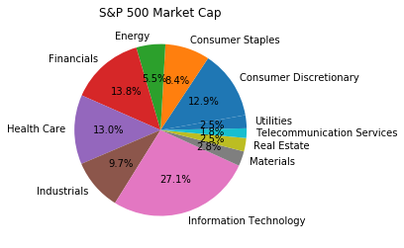
Step 1: Sector Analysis
Pie Chart Displaying All Sectors

Slide 6
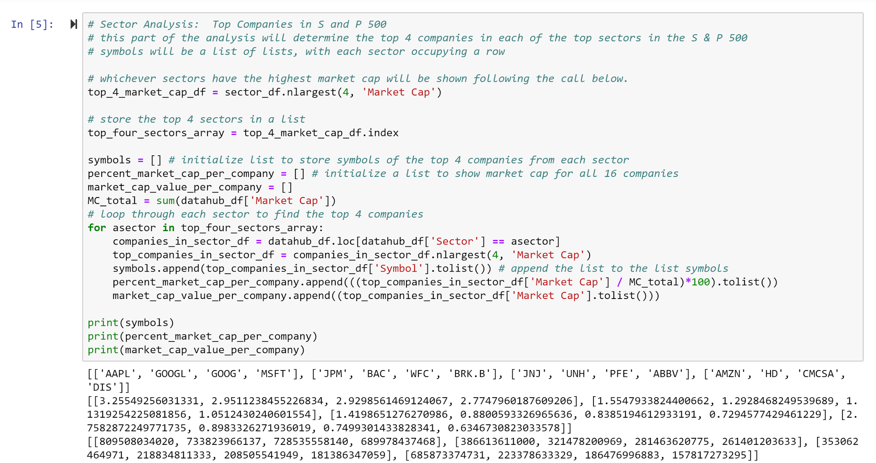
Step 2: Company Analysis
Loop to Find Top 4 Companies in Top 4 Sectors

Slide 7
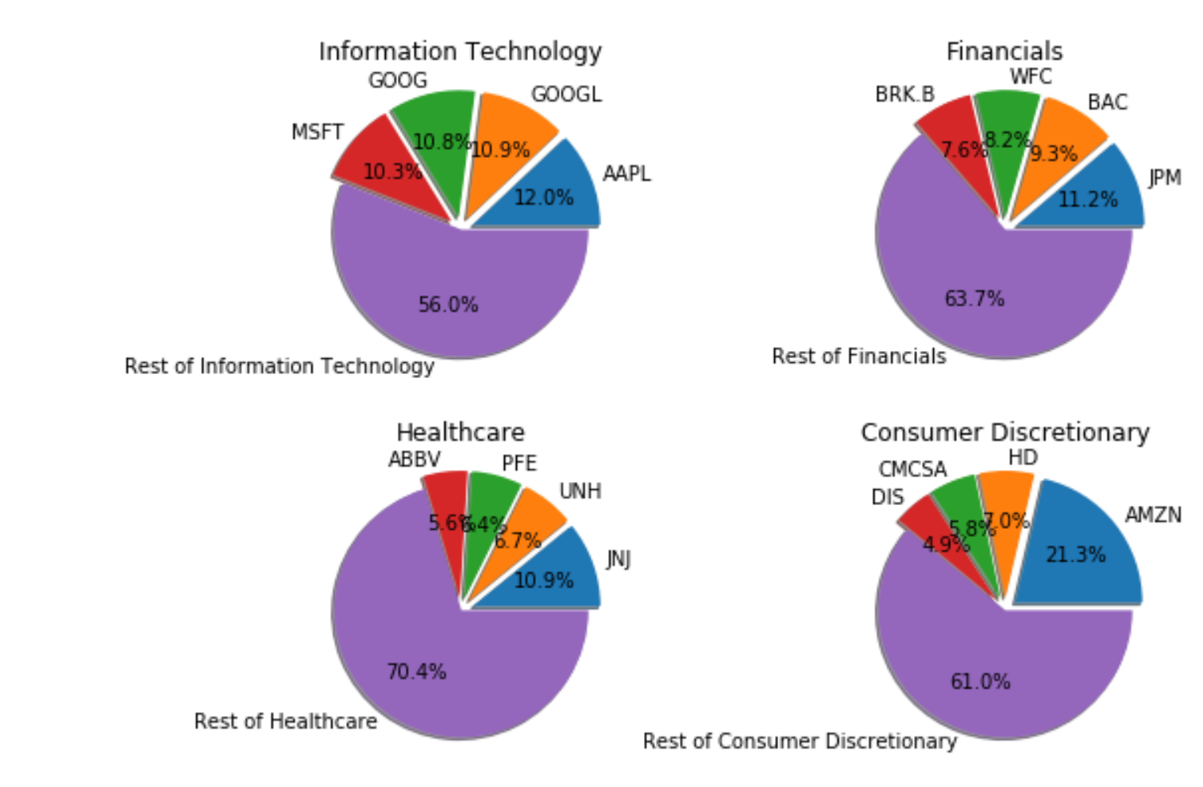
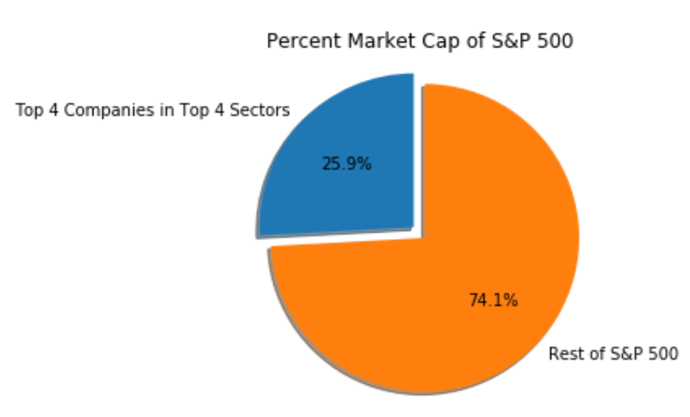
Step 2: Company Analysis
Make up of top 16 Companies within each Sector
Pie Chart/Bar Graph to Show Percent of Market Cap Relative to Entire S&P
Total 505 companies in S&P

Slide 8

Step 3: Impact of Each Top Company on Market
Data Scraping ("https://www.alphavantage.co/" )
URL Variables
Control Variables

Slide 9
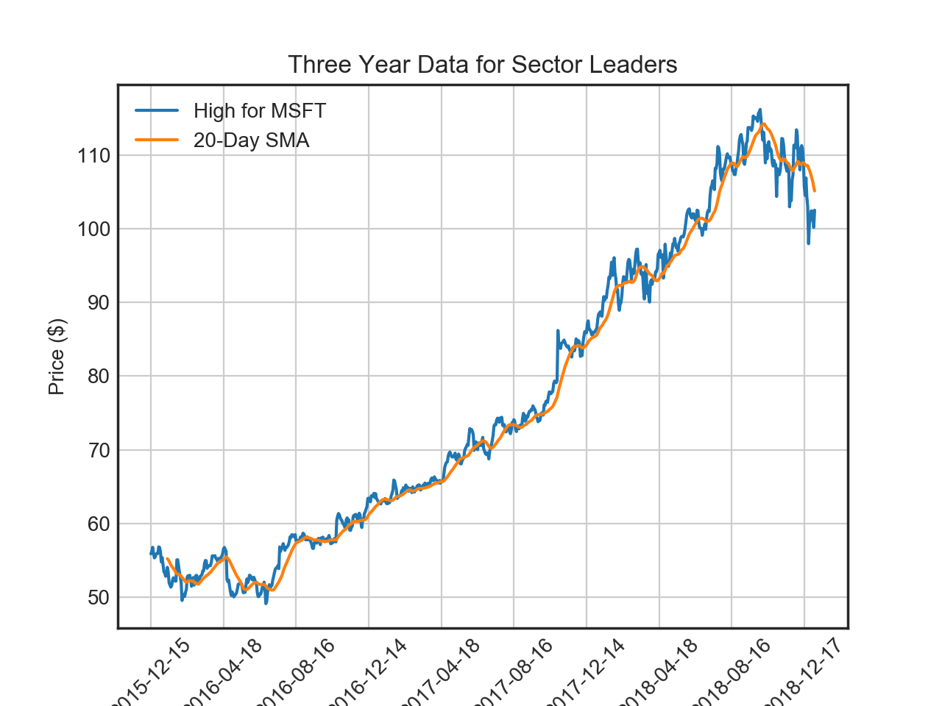
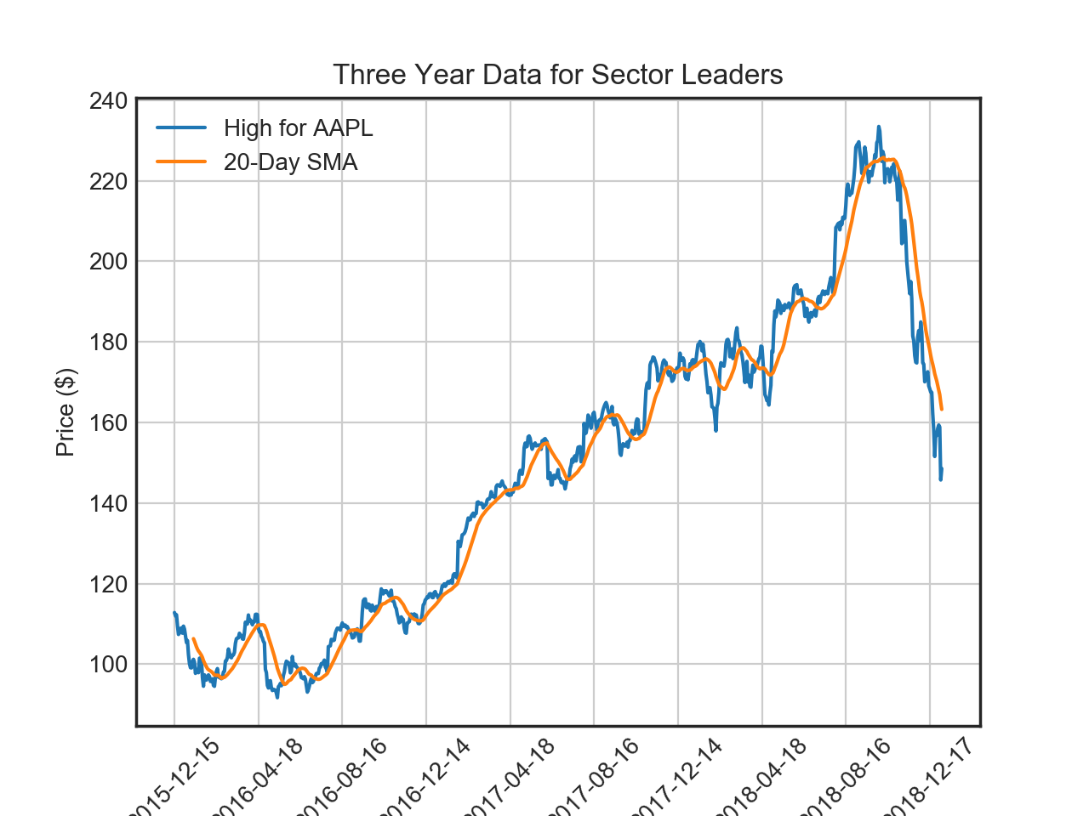
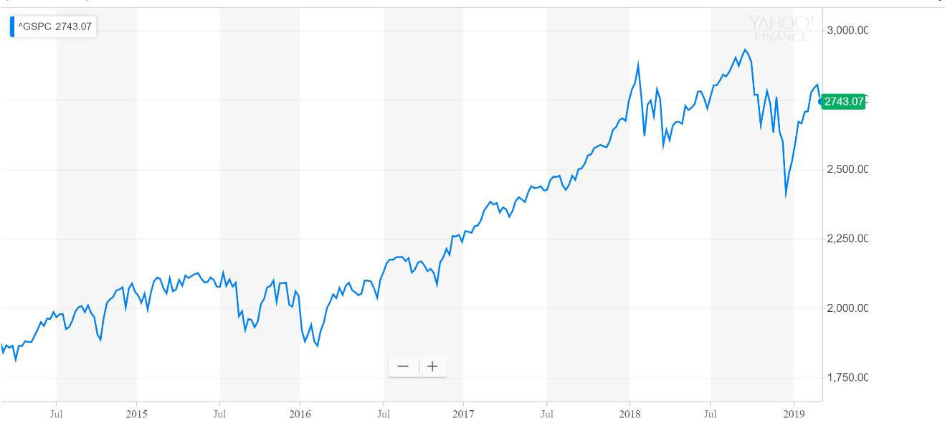
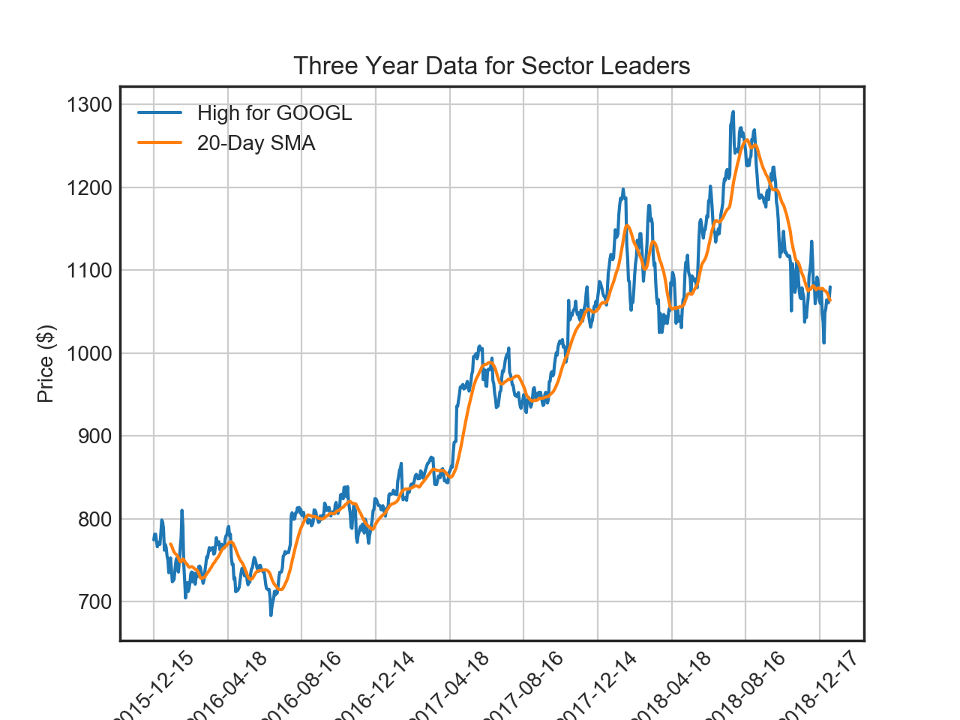
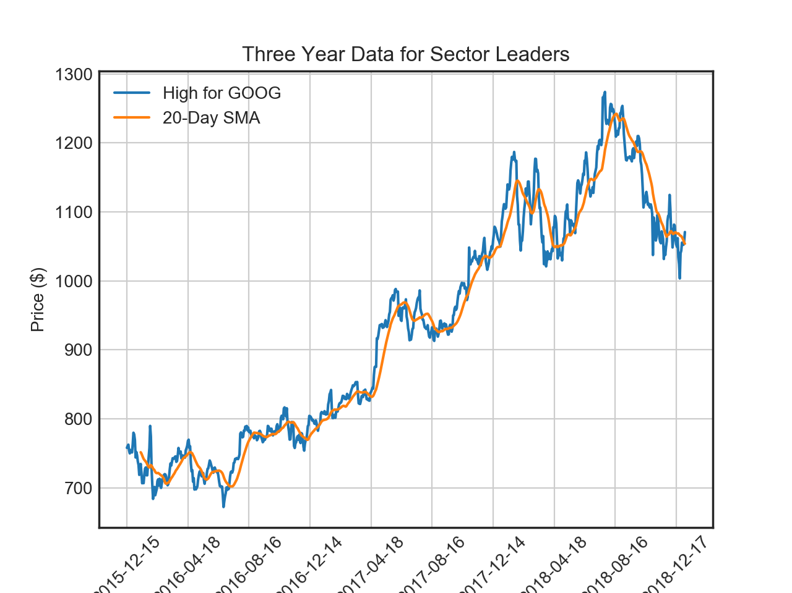
Step 3 (Continued)
Data Plotting: Information Technology
Greatest influence on market
S&P 500 3 year trend
Time Frame of Interest

Slide 10
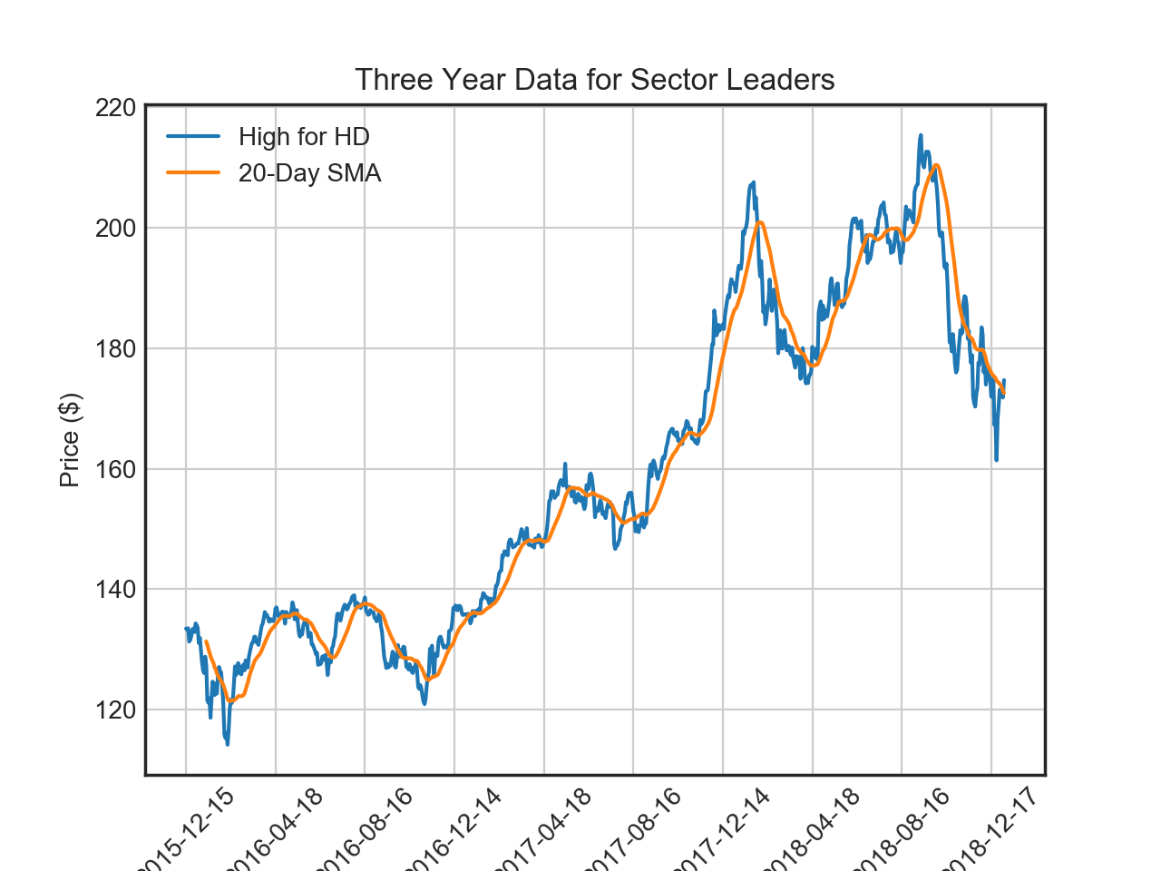
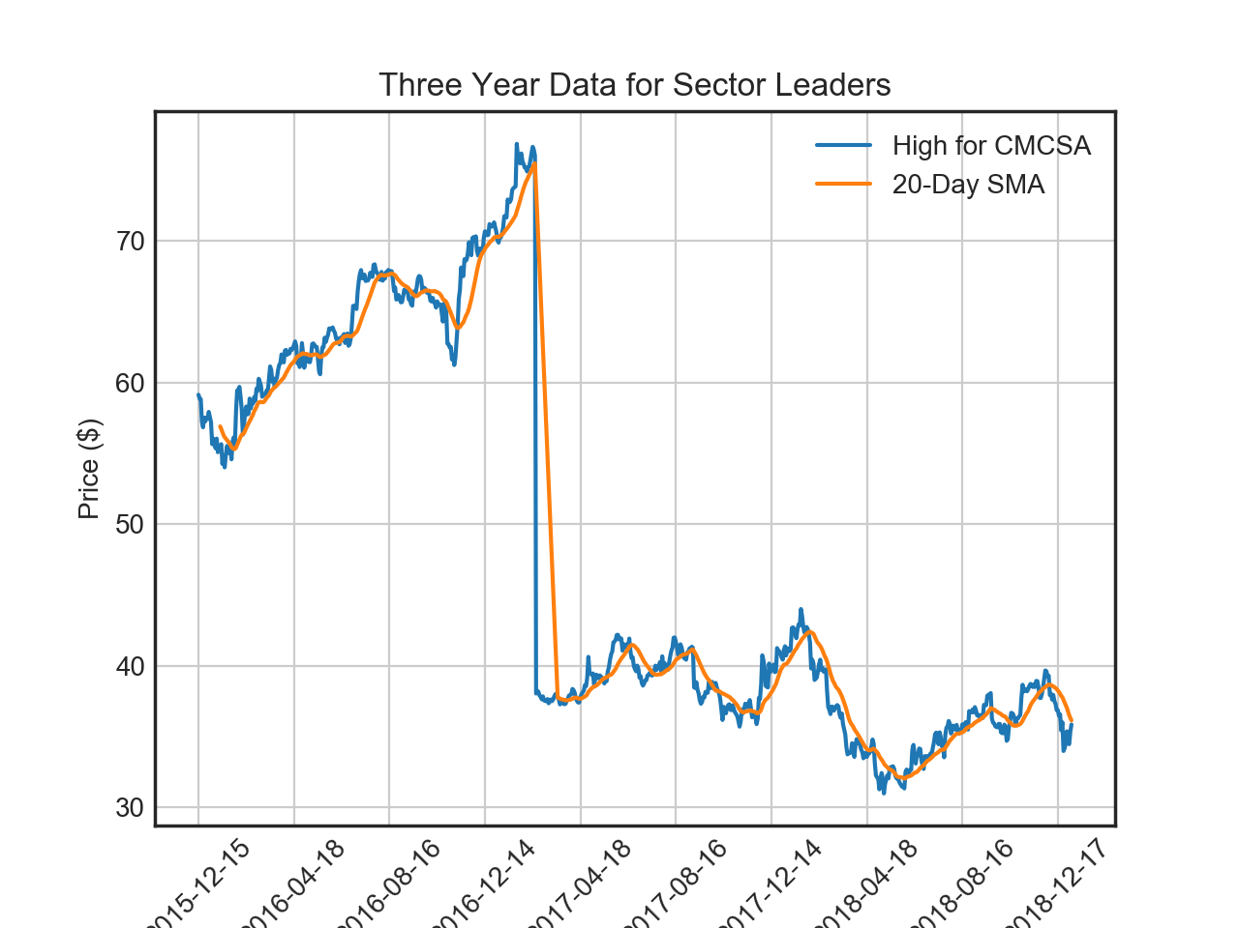
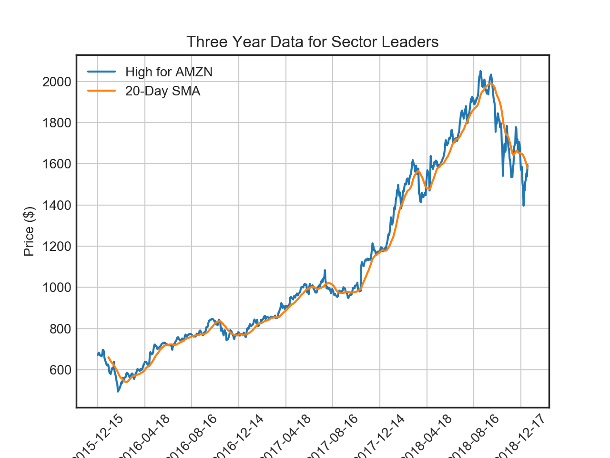
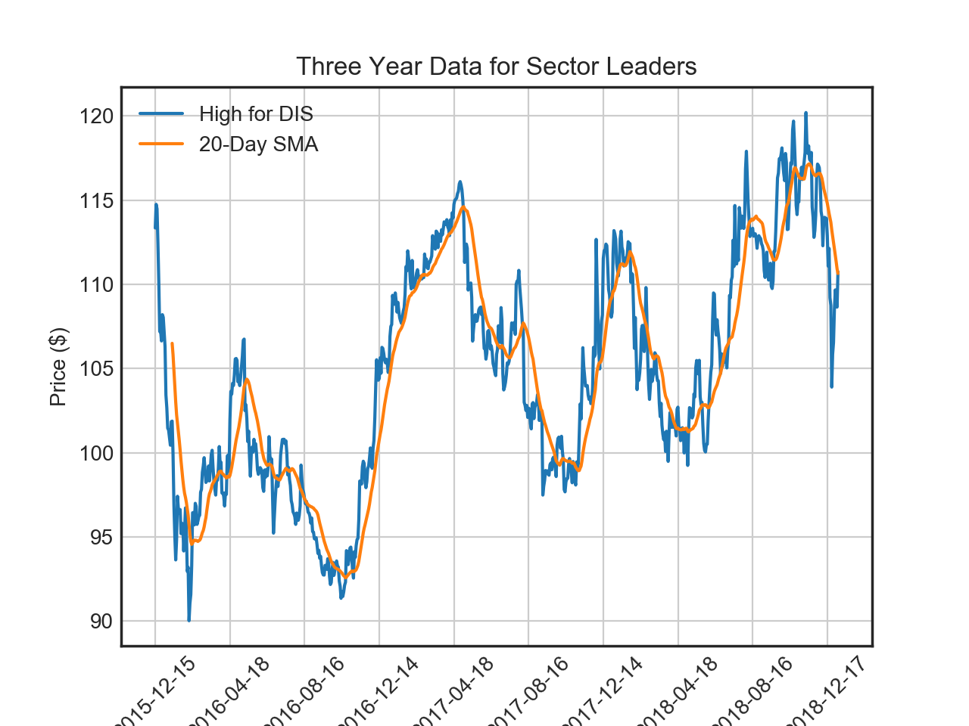
Step 3 (Continued)
Data Plotting: Consumer Discretionary
S&P 500 3 year trend
CMCSA drop in 2016

Slide 11
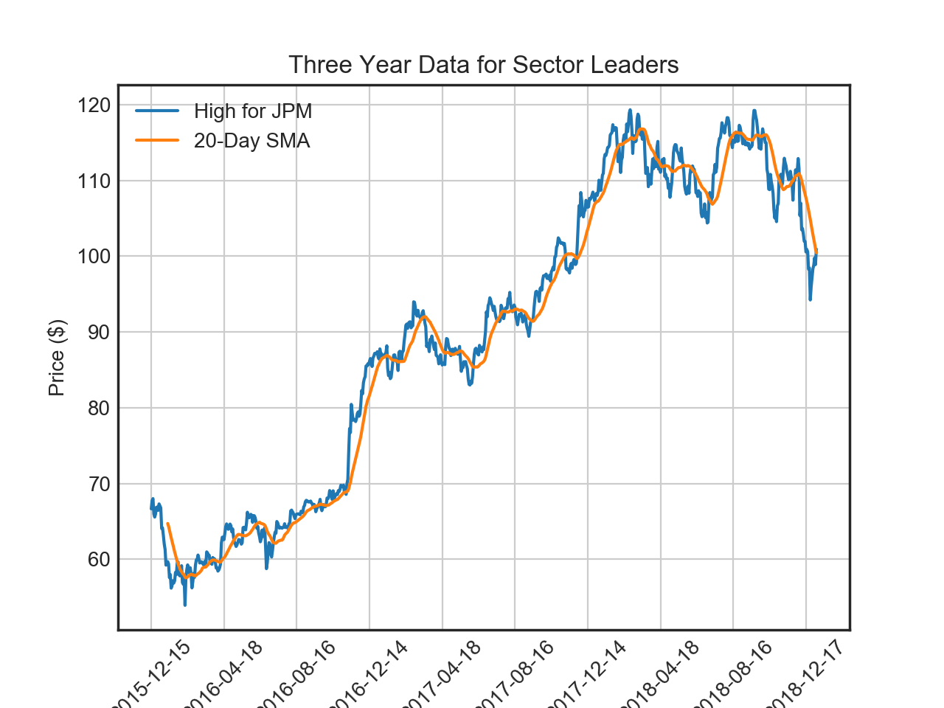
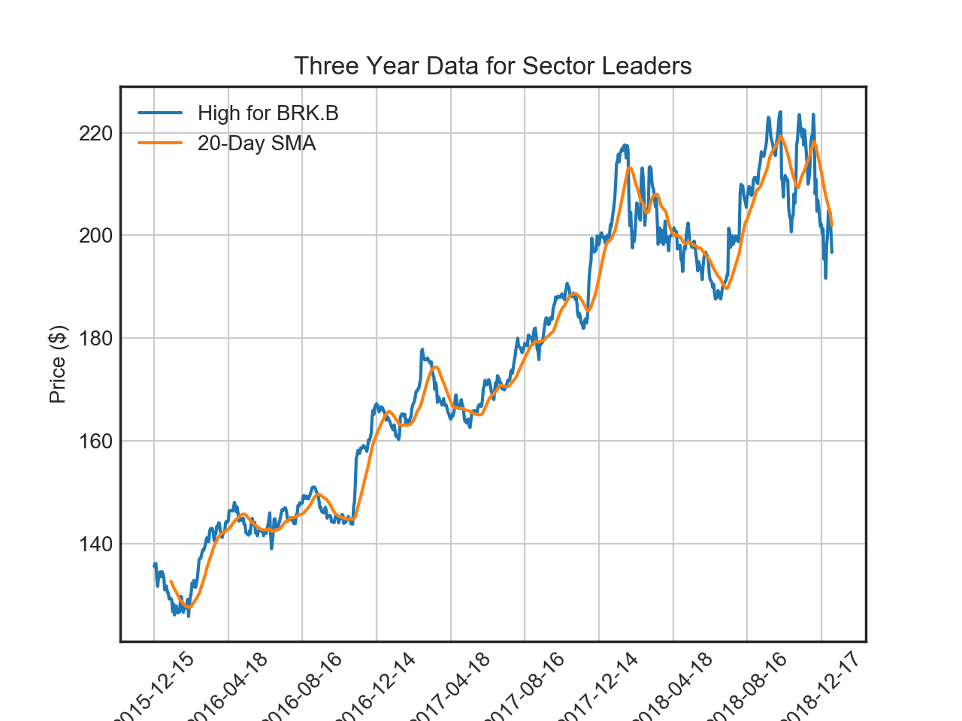
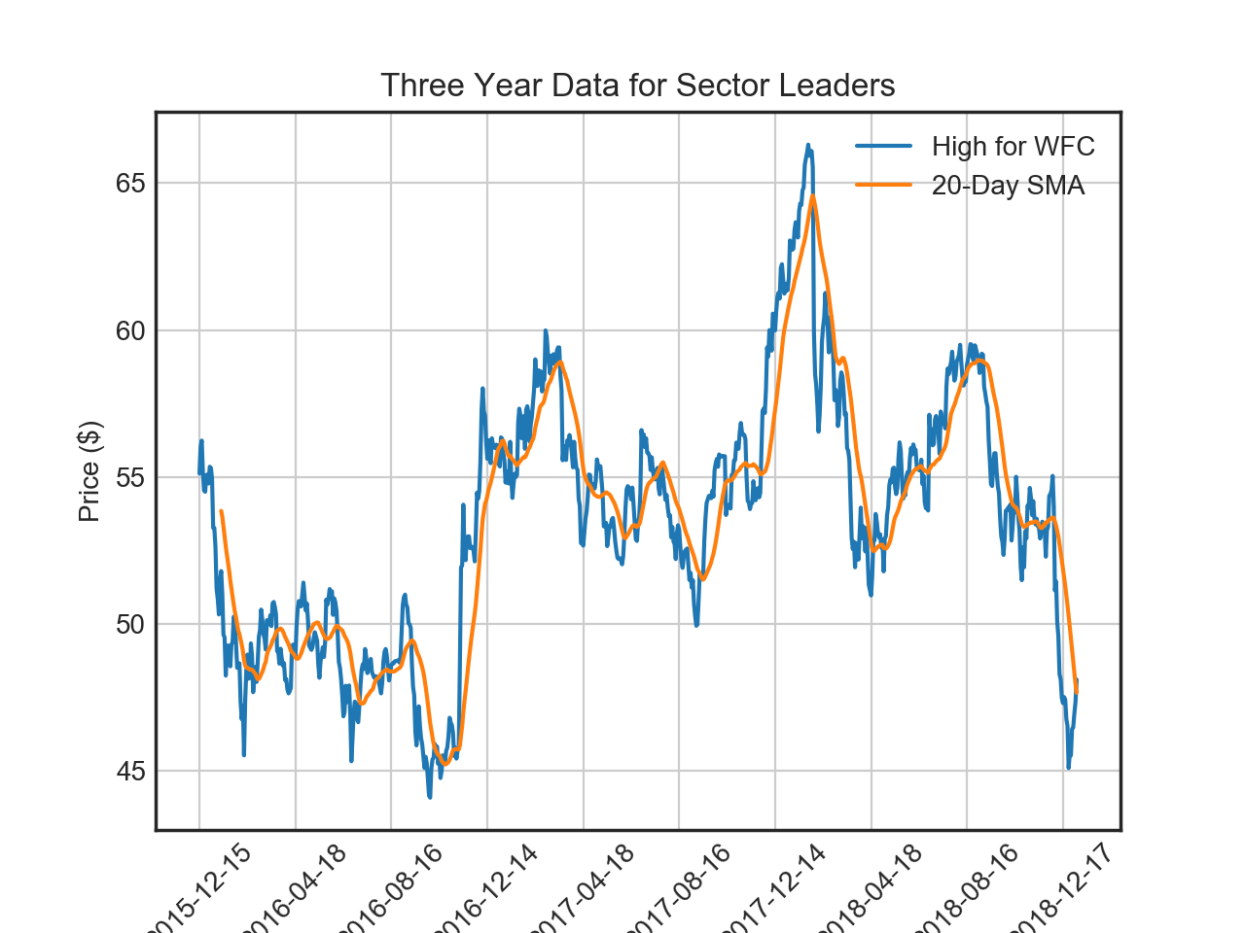
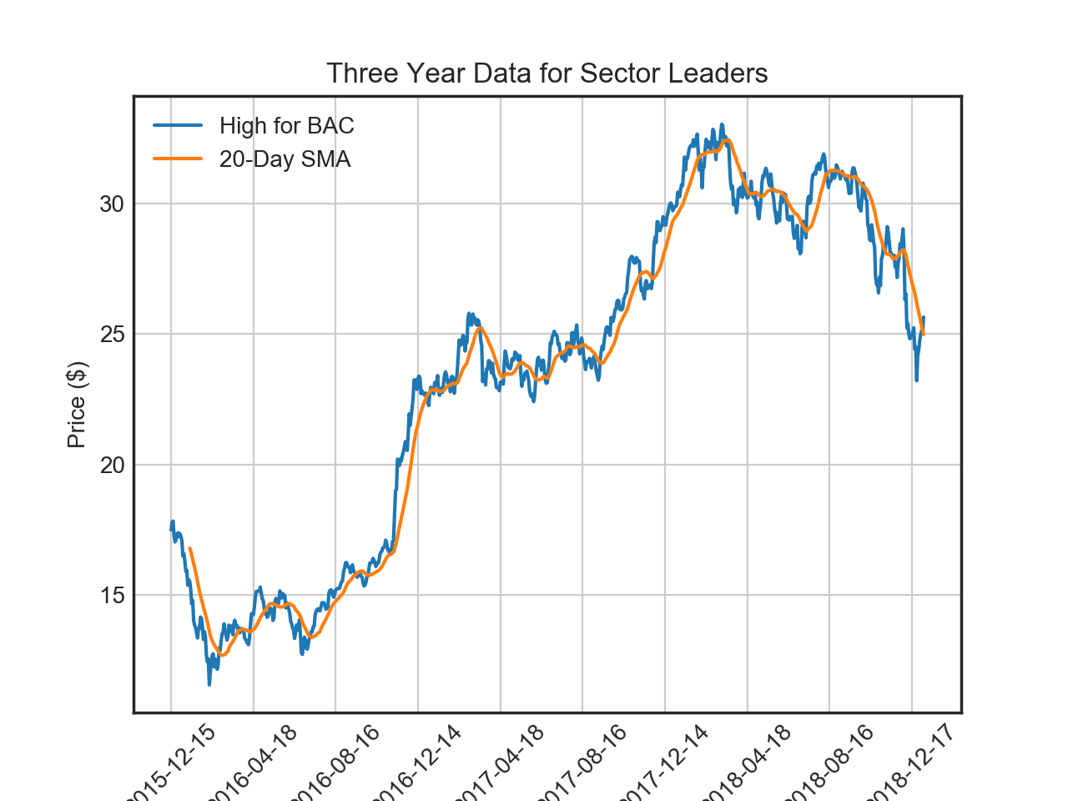
Step 3 (Continued)
Data Plotting: Financials
S&P 500 3 year trend
Doesn’t affect S&P very much overall, since lowest point in 2016 is similar to 2018

Slide 12
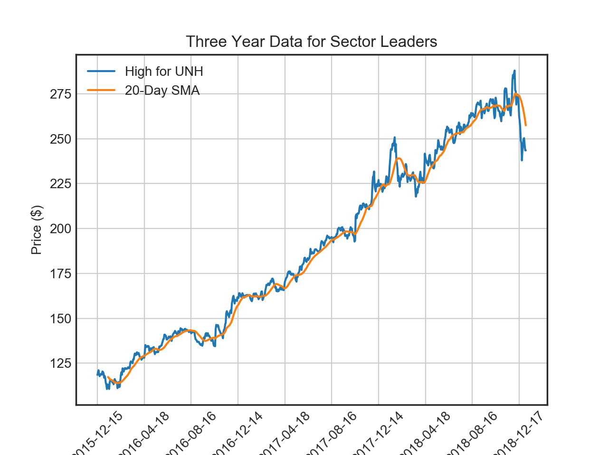
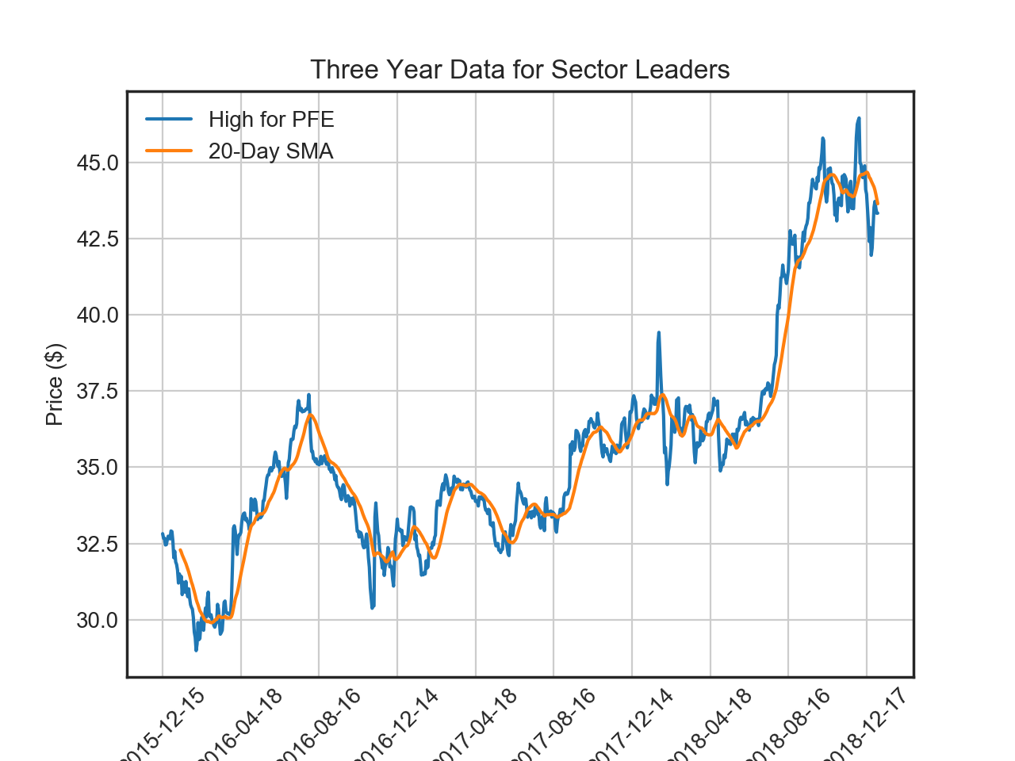
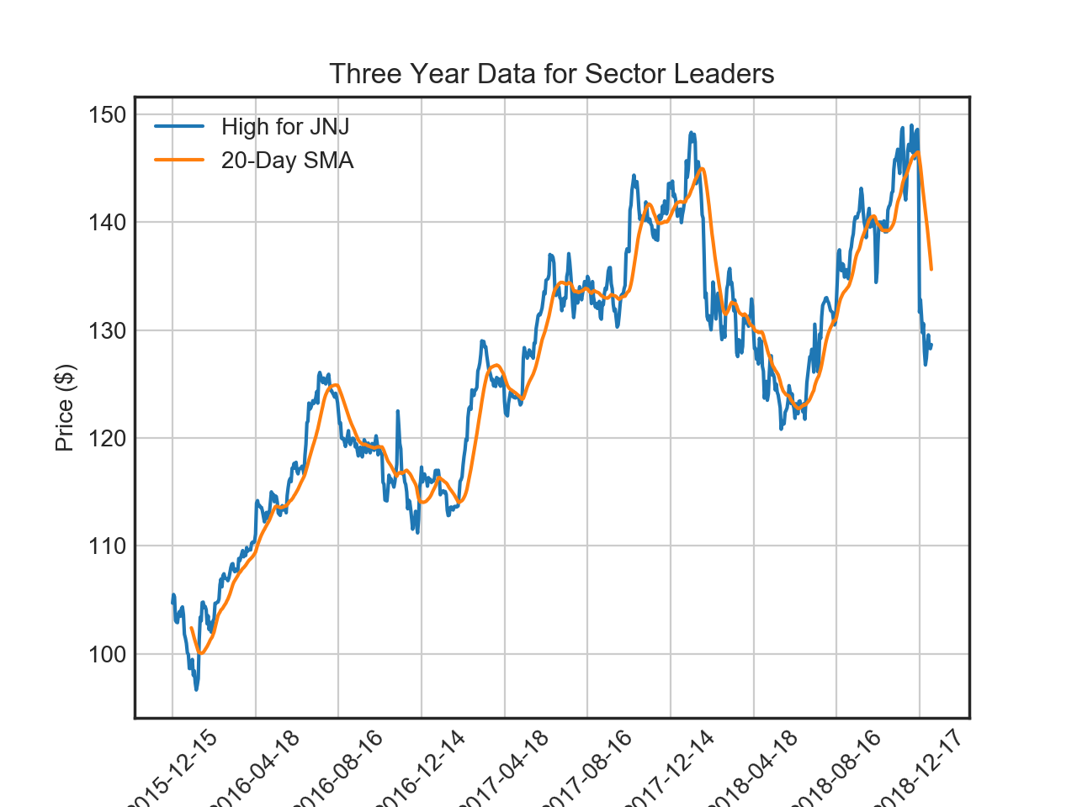
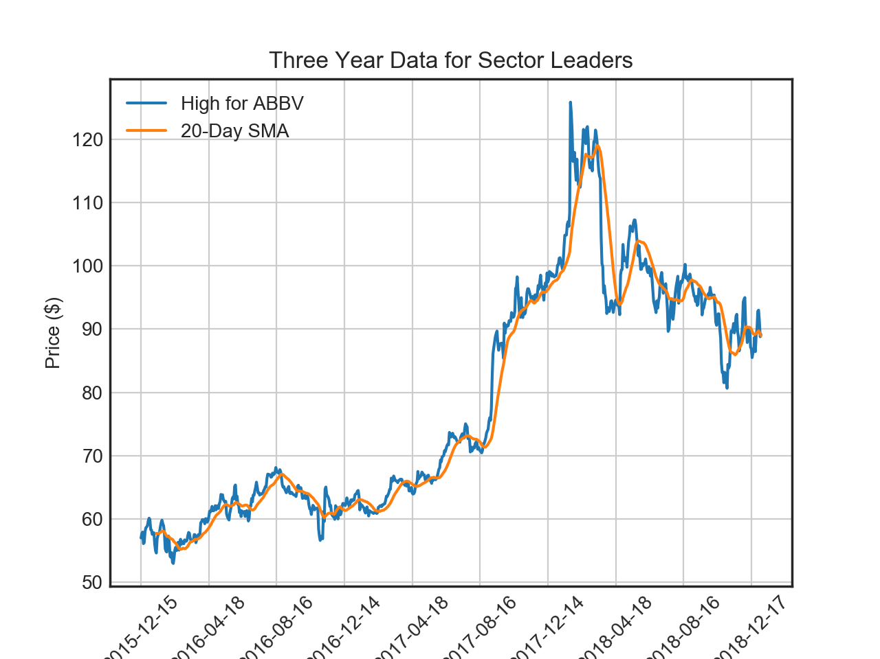
Step 3 (Continued)
Data Plotting: Healthcare
S&P 500 3 year trend

Slide 13


DEMO
Toolsets Used: Jupyter Notebook, Data Science Libraries in Python, Web Scraping Libraries

Slide 14
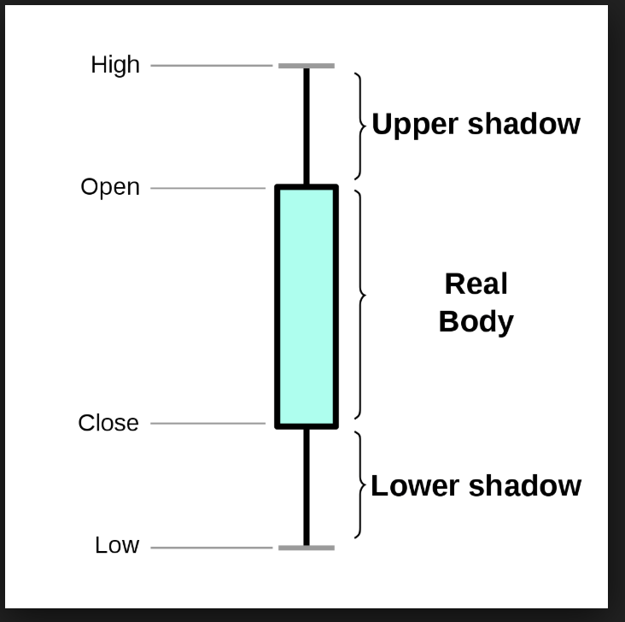
Project Considerations
Data Sources Used:
https://datahub.io/core/s-and-p-500-companies-financials/r/constituents-financials.csv
https://www.alphavantage.co/
Data Sources Consideration: Premium Alpha Vantage account
Future Project Considerations: Candlestick Plot to make an investment decision

Slide 15
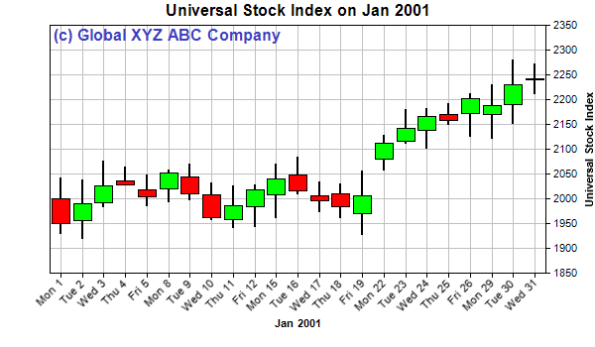
Candlestick Chart Example

Slide 16
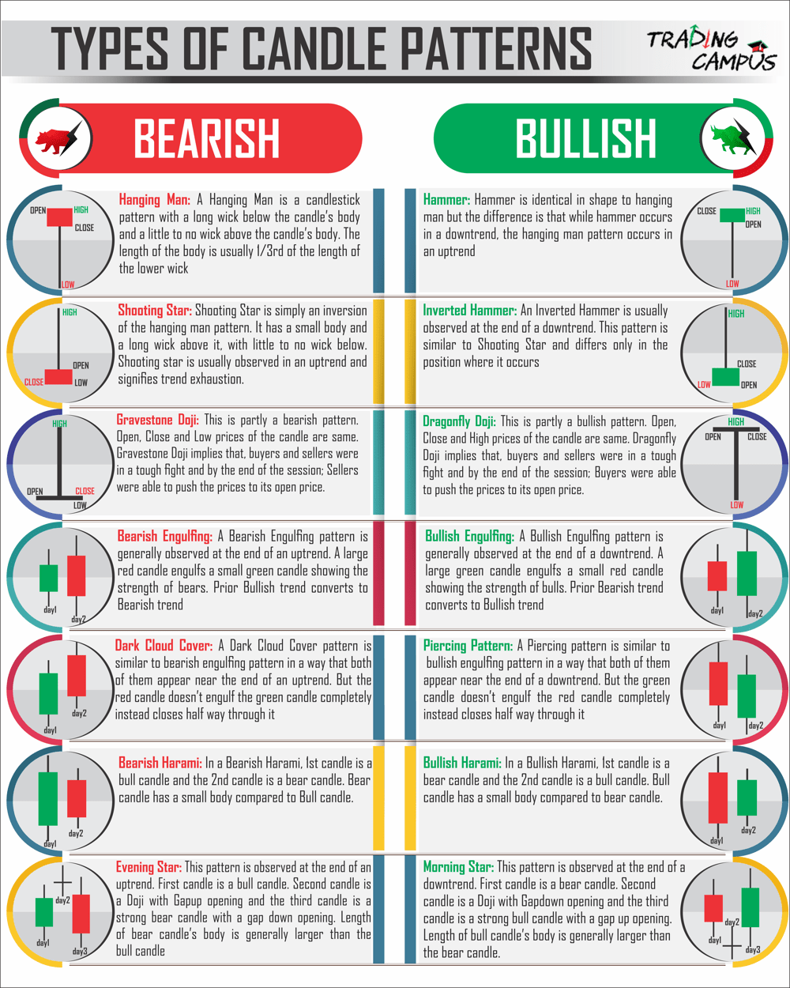
Candlestick Patterns

Slide 17

Q&A
Questions?

